Slide 1
104KM Enterprise Information System
Topic: Systems Analysis and Design
Learning outcomes for today
Part 1:
➔ Types of Systems
➔ What is a Database?
➔ Database Management System
Part 2:
➔ Entity Relationship Diagram (ERD)
➔ Relational Databases
Part 3:
➔ Examples

Slide 2
What is a System?
A collection of subsystems that are interrelated and interdependent , working together to accomplish predetermined goals and objectives.
Input
Process
Output
I – P – O

Slide 3
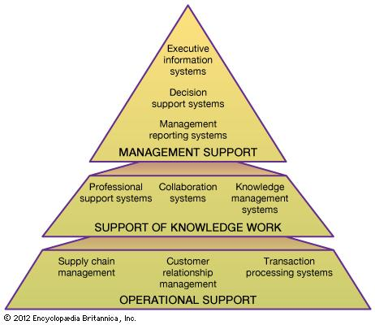
Types of Systems
Transaction Processing System (payroll, inventory)
Management Information System
Decision Support System
Expert Systems and Artificial Intelligence
CSCW Computer Supported
Collaborative Work System

Slide 4
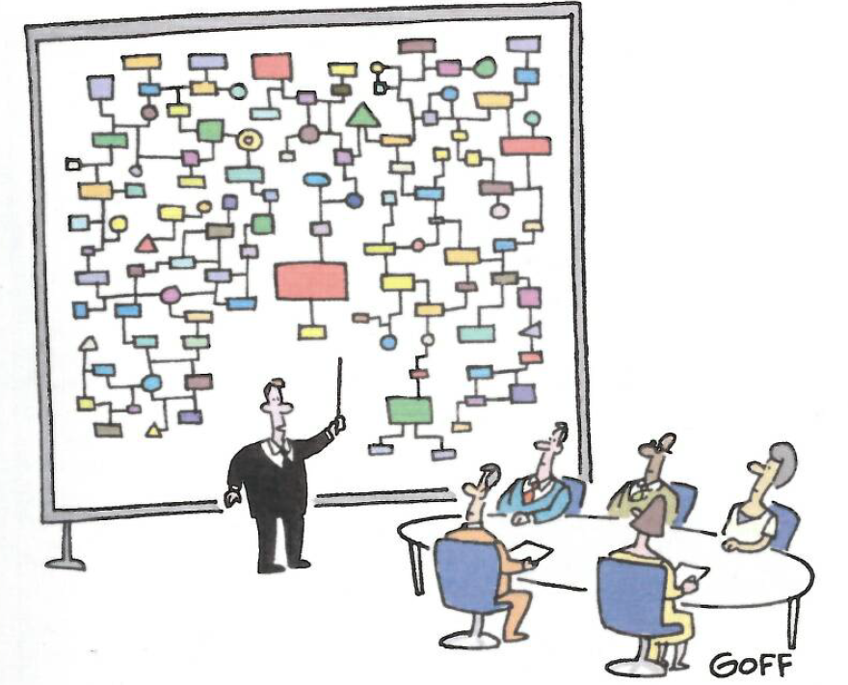
Need for Systems Analysis and Design
System analysis and design, as performed by system analyst, seeks to analyse data input or data flow systematically, processing or transforming data, data storage and information output within a context of a particular business.
“And that’s why we need a computer.”
<Source:@2003 Ted Goff from cartoonbank.com>

Slide 5
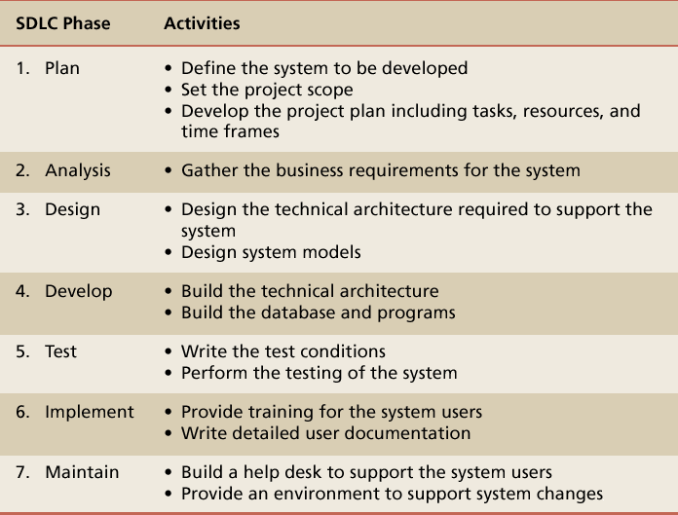
7 Phases of the Software Development Life Cycle (SDLC)

Slide 6
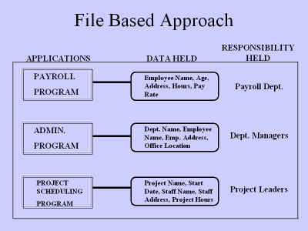
Files and Databases
File: A collection of records or documents dealing with
one organisation, person, area or subject. (Rowley)
- Manual (paper) files
- Computer files
Database: A collection of similar records with relationships between the records. (Rowley)
- Business data, statistical, images, etc.

Slide 7
Limitations of File-Based Approach
Separation and isolation of data
  Each program maintains its own set of data.
  Users of one program may be unaware of potentially useful data held by other programs.
Duplication of data
  Same data is held by different programs.
  Wasted space and potentially different values and/or different formats for the same item.

Slide 8
From File Systems to DBMS
Problems with file processing systems
  Inconsistent data
  Inflexibility
  Limited data sharing
  Poor enforcement of standards
  Excessive program maintenance

Slide 9
Terms and Concepts
Database A collection of stored operational data used by the application systems of some particular enterprise. (C.J. Date)
Database Management System A software that organizes data in a database providing information storage, organization and retrieval capacities.
CASE Tools Computer-Aided Software Engineering tools that include computer-based automated diagramming, analyzing and modeling capabilities.

Slide 10
Terms and Concepts
Metadata
- Data about data
  In DBMS means all of the characteristics describing the attributes
  of an entity, e.g.
  → name of attribute
  → data type of attribute
  → size of attribute
- Characteristics of files or relations
  Name, content, notes, etc…

Slide 11
Terms and Concepts
Data Dictionary
- The place where all metadata for a particular database is
stored.
- May also include information on relationships between files
or tables in a particular database.

Slide 12
Basic DBMS Functionality
Define a database: in terms of data types, structures and constraints
Construct or Load the Database on a secondary storage medium
Manipulating the database: querying, generating reports, insertions, deletions and modifications to its content
Concurrent Processing and Sharing by a set of users and programs – yet, keeping all data valid and consistent

Slide 13
Basic DBMS Functionality
Other features:
  Protection or Security measures to prevent unauthorized access
  “Active” processing to take internal actions on data
  Presentation and Visualization of data

Slide 14
DBMS Benefits
Minimal Data Redundancy
Consistency of Data
Integration of Data
Sharing of Data
Ease of Application Development
Uniform Security, Privacy, and Integrity Controls
Data Accessibility and Responsiveness
Data Independence
Reduced Program Maintenance

Slide 15
Examples of Database Applications
Purchases from the supermarket
Purchases using your credit card
Booking a holiday at the travel agents
Using the local library
Taking out insurance
Using the Internet
Studying at university
Many more …….

Slide 16
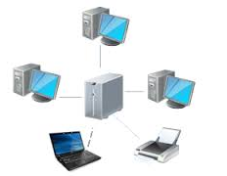


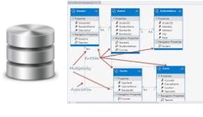

DBMS - Components
Hardware
  PC, workstation, mainframe, a network of computers.
Software
  A set of programs used to control and managed the database (this includes
  the DBMS s/w, the OS, the network being used to share the data,
  and the application programs used to access data in the DBMS).
Data
Used by the organization and a description of this data
called the schema.
DBMS exists to collect, store, process and access data.
Procedures
  Instructions and rules that should be applied to the design and use of the database and DBMS. These are the instructions and rules that assist on how to use the DBMS, and in designing and running the database, using documented procedures, to guide the users that operate and manage it.
People

Slide 17



Top DBMS Software
Oracle RDBMS is the best RDBMS, running on multiple platforms, with the latest version 12c, in which the "c" is for cloud computing.
In the IT industry, Oracle is "THE DATABASE."
IBM DB2 DB2 is the database management system that delivers a flexible and cost-effective database platform to build robust on demand business applications.
Microsoft SQL is a comprehensive database software platform providing enterprise-class data management and integrated business intelligence (BI) tools

Slide 18



Top DBMS Software
SAP Sybase ASE SAP Adaptive Server Enterprise, formerly Sybase, is a high-performance, mission-critical database management system that gives customers an operational advantage by lowering costs and risks.
MySQL is an open source database is the most popular database for web-based business applications, and is moving to enterprise level. MySQL is the most popular database for internet systems such as e-commerce and dynamic website.
Microsoft Access is the most used desktop database application in Windows. Coming with the Microsoft Office suite, Access is cheap and accessible from most Windows laptops and workstations. Although mainly considered as a desktop database, Access becomes ever popular database for internet systems, - many e-commerce and content management systems is powered by Access database running on the Microsoft's IIS web server platform.

Slide 19

Our Hero --- E. F. Codd
Edgar F. "Ted" Codd ( August 23, 1923 - April 18, 2003) was a British computer scientist who invented relational databases while working for IBM.
He was born in Portland, Dorset, studied maths
and chemistry at Oxford. He was a pilot in the
Royal Air Force during WWII. In 1948 he joined IBM
in New York as a mathematical programmer. He fled
the USA to Canada during the McCarthy period.
Later, he returned to the USA to earn a doctorate in CS
from the University of Michigan in Ann Arbor. He then
joined IBM research in San Jose.
His 1970 paper “A Relational Model of Data for
Large Shared Data Banks” changed everything.
In the mid 1990’s he coined the term OLAP.

Slide 20
Part 2
Entity Relationship Modelling (ERD)

Slide 21
Objectives
To be able to identify symbols used in ERD.
To be able to identify cardinality symbols to use
for different entity relationship types.
To be able to create an ERD to visually represent a database design.

Slide 22
Building Data Model
3 – Stage Approach to Building Database
Data Model
Entity Relationship Diagrams
Data Tables

Slide 23
Building Data Models
Data Model – represents the conceptual view of the organisation’s data
Entity-Relationship Diagrams – represent the logical view of how the data are organised
Data Tables – represent the physical view of the data

Slide 24
Building Data Model
3 – Stage Approach to Building Database
Data Model
Conceptual
Entity Relationship Diagrams
Logical
Data Tables
Physical

Slide 25
What is Entity Relationship Diagram?
Is a diagram used to conduct data modelling activity
It describes the relationship between data object.
DBA and System Analyst used ERD to perform data modelling, and explain the diagram to stakeholders.

Slide 26
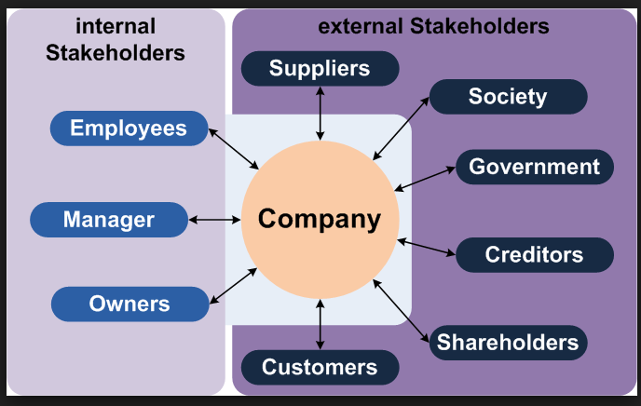
Stakeholders in a Business
Stakeholder, a person, group, organisation, or system who affects or can be affected by an organisation’s actions.
Stakeholders can affect or be affected by the organization's actions, objectives and policies.

Slide 27
Data Modeling Terms
Entity – a class of real world objects
Attribute – A characteristic or property of an entity
Relationship – an association between two or more entities
Cardinality – the number of entities on either end of a relationship (one-to-one, one-to-many, many-to-many, etc.)

Slide 28
Building Blocks of ERD
Type | English Grammar Equivalent | Example
Entity | Proper Noun | Student, Employee, Instructor, Courses, Room
Relationship | Verb | has, teaches, belongs, handles
Attribute | Adjective | Height, Age, Gender, Nationality, First name

Slide 29
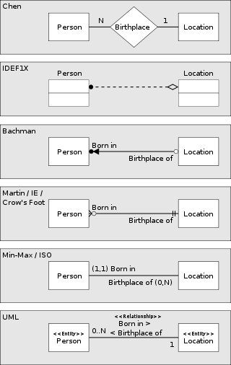
ERD Popular Notation

Slide 30
Chen Notation - Symbol
Rectangle represents an Entity
Diamond represents a Relationship
1
M
Lines with labels represents Cardinality

Slide 31
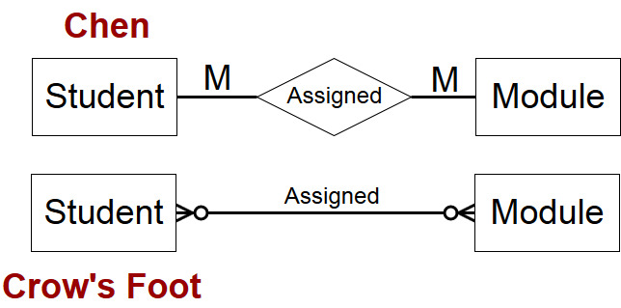
Entity Relationship Diagram

Slide 32
Entity-Relationship Modelling
E/R Modelling is used for conceptual design
  Entities - objects or items of interest
  Attributes - facts about, or properties of, an entity
  Relationships - links between entities
Example
  In a University database we might have entities for Students, Modules and Lecturers. Students might have attributes such as their ID, Name, and Course, and could have relationships with Modules (enrolment) and Lecturers (tutor/tutee)

Slide 33
Entity-Relationship Diagrams
Chen’s Diagram
Crow’s Feet
Lecturer
ID
Lecturer
ID
1
Name
Course
Student
Tutors
Name
ID
Course
Tutors
Student
Studies
M
M
Module
Module
M
Studies
ID

Slide 34
Entities
Entities represent objects or things of interest
  Physical things like students, lecturers, employees, products
  More abstract things like modules, orders, courses, projects
Entities have
  A general type or class, such as Lecturer or Module
  Instances of that particular type, such as Mary, John are instances of Lecturer
  Attributes (such as name, email address)

Slide 35
Diagramming Entities (Chen’s)
In an E/R Diagram, an entity is usually drawn as a box with rounded corners
The box is labelled with the name of the class of objects represented by that entity
Lecturer
ID
1
Name
Course
Tutors
Student
M
M
Module
Studies
M

Slide 36
Diagramming Entities (Crow’s)
Crow’s Feet
An entity is usually drawn in the header of a rectangular box
The box is labelled with the name of the class of objects represented by that entity
Lecturer
ID
Tutors
Student
Name
ID
Course
Studies
Module
ID

Slide 37
Attributes
Attributes are facts, aspects, properties, or details about an entity
  Students have IDs, names, courses, addresses, …
  Modules have codes, titles, credit weights, levels, …
Attributes have
  A name
  An associated entity
  Domains of possible values
  Values from the domain for each instance of the entity they are belong to

Slide 38
Diagramming Attributes (Chen’s)
In an E/R Diagram attributes may be drawn as ovals
Each attribute is linked to its entity by a line
The name of the attribute is written in the oval
Lecturer
ID
1
Name
Course
Tutors
Student
M
M
Module
M
Studies

Slide 39
Diagramming Attributes (Crow’s)
The attributes are listed in the Entity box
Each attribute is linked to its entity by a line
The name of the attribute is written in the oval
Lecturer
ID
Tutors
Student
Name
ID
Course
Studies
Module
ID

Slide 40
Relationships
Relationships are an association between two or more entities
  Each Student takes several Modules
  Each Module is taught by a Lecturer
  Each Employee works for a single Department
Relationships have
  A name
  A set of entities that participate in them
  A degree - the number of entities that participate (most have degree 2)
  A cardinality ratio

Slide 41
Diagramming Relationships (Chen’s)
Relationships may be drawn as diamonds
Each relation connects two entities
The name of the relationship is written in the oval
There are multiple types of relationships
Lecturer
ID
1
Name
Course
Tutors
Tutors
M
Student
M
Studies
Module
M
Studies

Slide 42
Diagramming Relationships(Crow’s)
In an E/R Diagram relationships may be drawn as connecting lines
Each relation connects two entities
The name of the relationship is written above the connecting line
There are multiple types of relationships
Lecturer
ID
Tutors
Student
Name
ID
Course
Studies
Module
ID

Slide 43
Cardinality Ratios
One to none (1:0)
  A module may or may not have a module leader
One to one (1:1)
  Each lecturer has a unique office
One to many (1:M)
  A lecturer may tutor many students, but each student has just one tutor
Many to none (M:0)
  A module may or may not have any students
Many to many (M:M)
  Each student takes several modules, and each module is taken by several students
Each entity in a relationship can participate in zero, one, or more than one instances of that relationship

Slide 44
Types of Entity Relationships
Required(Y/N)?
Multiplier
Mandatory
Optional
Many
Many

Slide 45
Types of Entity Relationships
Required(Y/N)?
Multiplier
Mandatory
Optional
One
One

Slide 46
Degree of Relationship
There are three Degree of Relationships in ERD notation, namely:
  Unary
  Binary
  Ternary

Slide 47
Degree of Relationship (Cont’d)
Manages
Unary
Employee
Customer
makes
Orders
Binary
Vendor
Warehouse
Ternary
supplies
Part

Slide 48
Simple ERD Example
Manages
Code
Name
Name
Employee
Is_a_Member
Department
Dept ID
Age
Salary
Participates
Start Date
has
Start Date
City
Name
Project
Branch
Budget
Address
Release Date

Slide 49
Attribute – More Example
CustomerName
Lastname
CustomerNum
Firstname
RepNum
Street
Street
City
Sales Rep
1
represents
M
City
Customer
State
State
Rate
CreditLimit
Zip
Zip
Commission
Balance

Slide 50
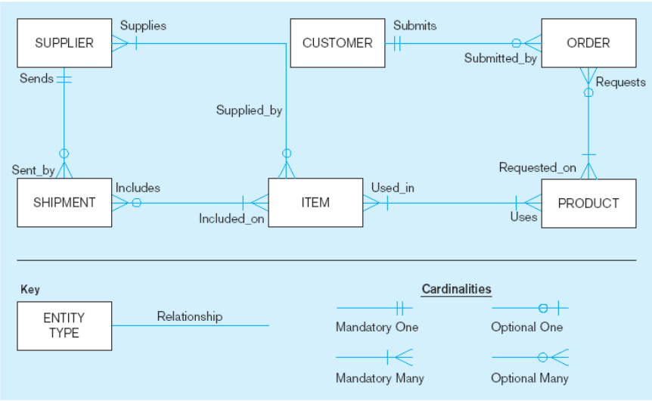
Sample E-R Diagram

Slide 51
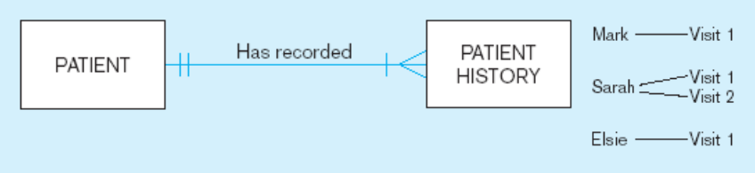
Sample E-R Diagram
A patient must have recorded at least one history, and can have many.
A patient history is recorded for one and only one patients.

Slide 52
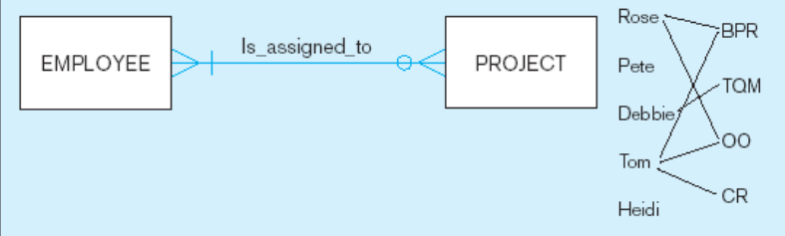
Sample E-R Diagram
An employee can be assigned to any number of projects, or may not be assigned to any at all.
A project must be assigned to at least one employee, and may be assigned to many.

Slide 53
Some systems to play with
mysql:
  www.mysql.org
PostgreSQL:
  www.postgresql.org
Commercial systems:
  Oracle (www.oracle.com)
  SQL Server 2000 (www.microsoft.com/sql)
  DB2 (www.ibm.com/db2)

Slide 54
Next Lecture
Relational Databases
SQL

Slide 55
Summary
Data Dictionary
Unified Modelling
Language
Data Flow Diagram
Systems Development Life Cycle
Analysis Process
OO Systems Analysis and Design
Systems Analysis and Design of Information Systems
Types of
Systems
Software Engineering and Implementation
Entity Relationship
Diagram
Design Process
Databases
Design
User Interfaces (Structured Query Language)
Relational Databases

